Slide 1
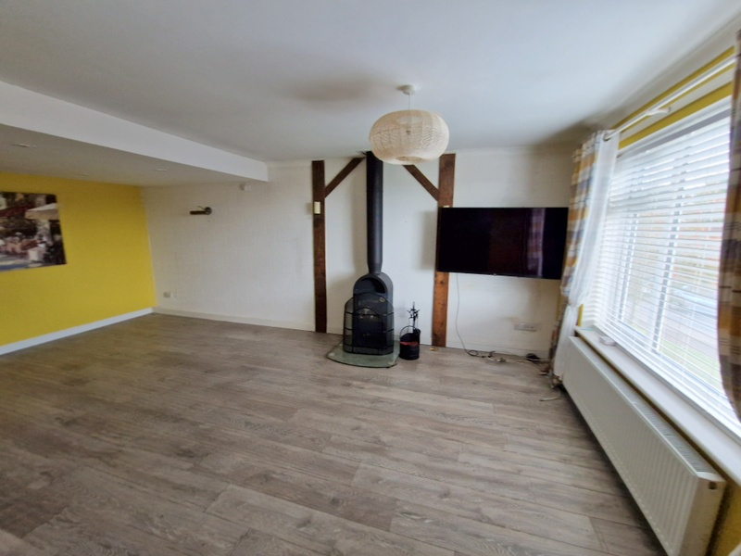
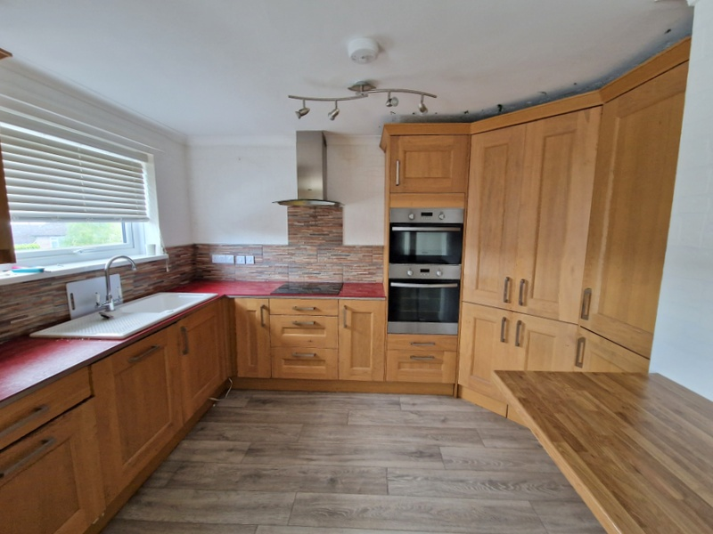
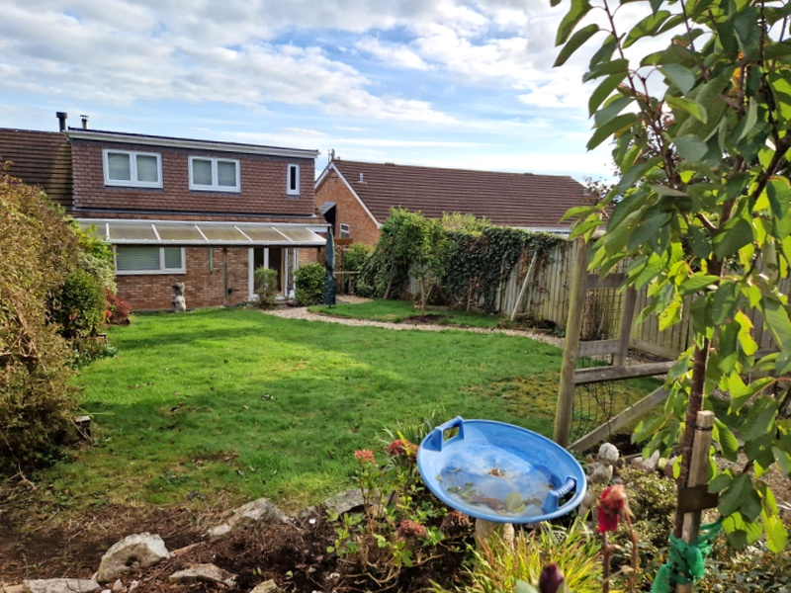
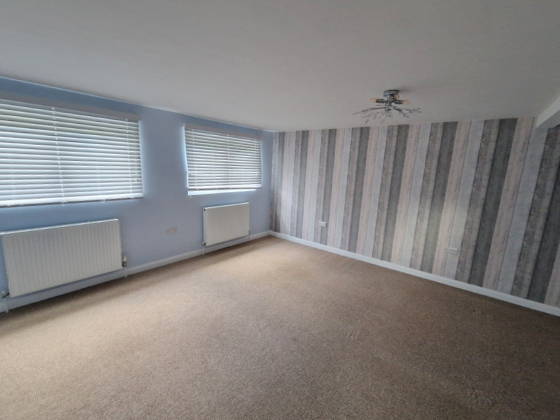
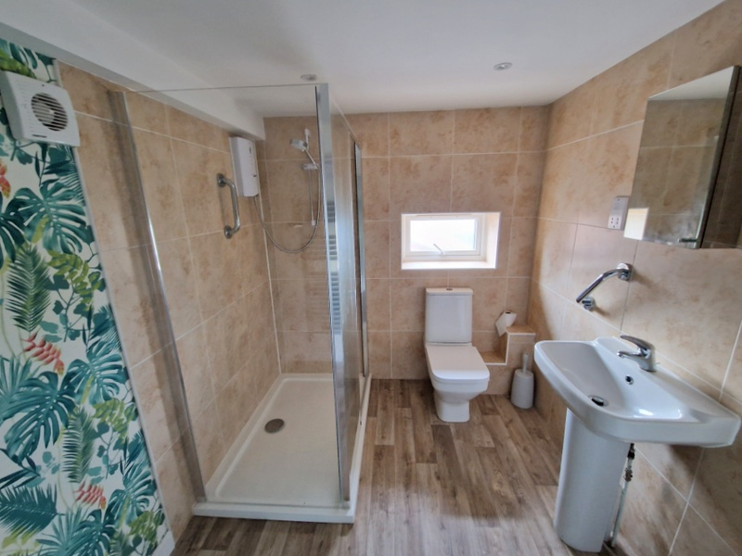
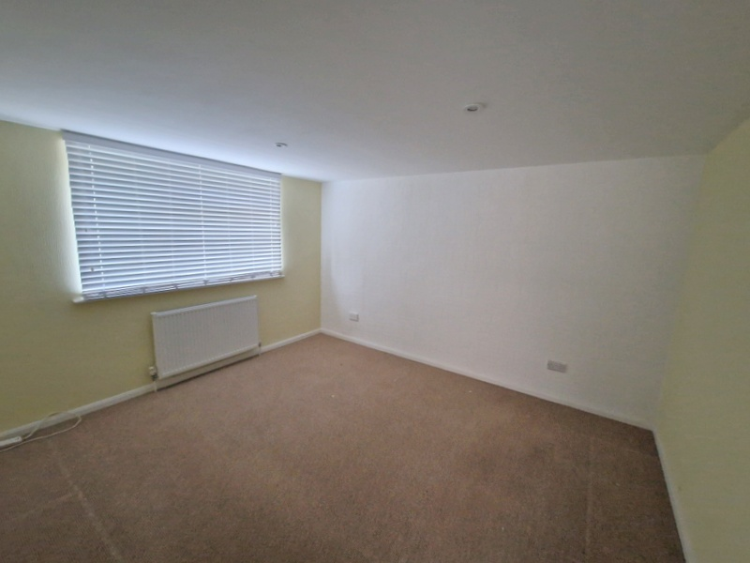
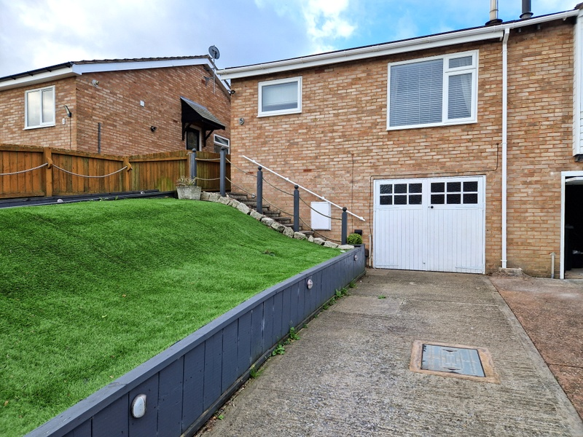
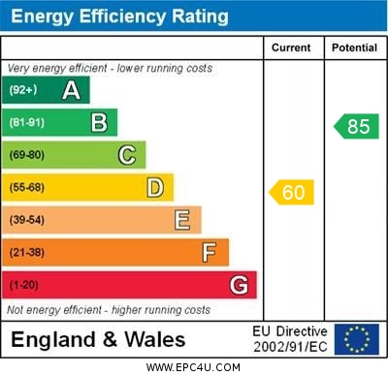
www.pennys.net
5 Hadrian Drive, Exeter, EX4 1SR
GUIDE PRICE £315,000
TENURE Freehold
Semi Detached Chalet Style Bungalow With Lovely Size Rooms Located In A Favoured Area Of Exeter With Lovely Gardens, Driveway Parking And Large Garage
Entrance Porch And Reception Hall * Open-Plan Lounge/Dining Room * Kitchen/Breakfast Room * Ground Floor Double Bedroom * Single Bedroom/Study * Stylish Shower Room/Wc * Stunning First Floor Main Bedroom Suite With Walk-In Dressing Area And Shower Room/Wc * Superb Gardens * Gas Central Heating * Double Glazed Windows No Onward Chain
Pennys Estate Agents Limited for themselves and for the vendor of this property whose agents they are give notice that:- (1) These particulars do not constitute any part of an offer or a contract. (2) All statements contained in these particulars are made without responsibility on the part of Pennys Estate Agents Limited. (3) None of the statements contained in these particulars are to be relied upon as a statement or representation of fact. (4) Any intending purchaser must satisfy himself/herself by inspection or otherwise as to the correctness of each of the statements contained in these particulars. (5) The vendor does not make or give and neither do Pennys Estate Agents Limited nor any person in their employment has any authority to make or give any representation or warranty whatever in relation to this property.
PENNYS ESTATE AGENTS
2 Rolle House, Rolle Street, Exmouth, Devon, EX8 2SN
Tel: 01395 264111 EMail: help@pennys.net

Slide 2
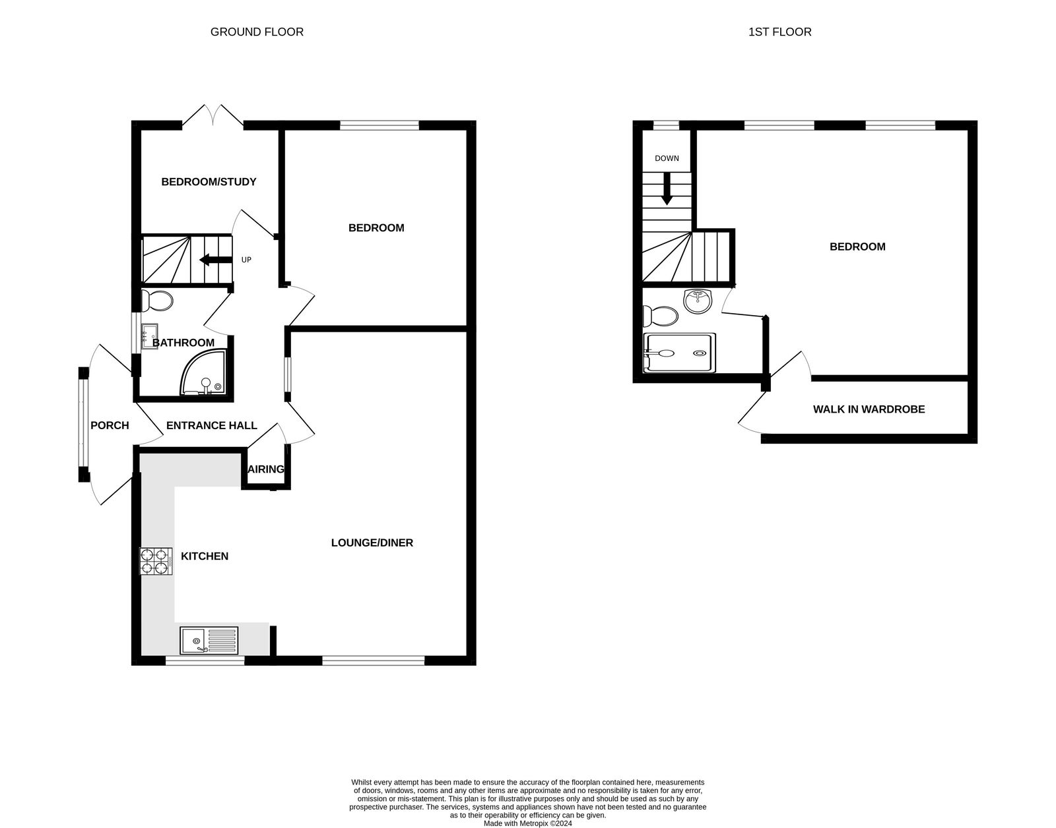
5 Hadrian Drive, Exeter, EX4 1SR
Located in the ever popular Redhills area of Exeter on the Western fringes of the City, yet offering convenient access to the City centre, nearby facilities, St. Davids train station along within easy access onto the A30.
The property has been transformed over recent years and offers contemporary style living space. The accommodation includes an open plan main living room with wood burner stove opening through to a kitchen/breakfast room. On the ground floor there is a double bedroom, single bedroom/study and a stylish shower room/wc. On the first floor there is a superb main bedroom suite with walk-in dressing room and en-suite shower room/wc. Outside at the front there is a level driveway providing off-road parking leading to a large integral garage. The front garden is landscaped with ease of maintenance in mind and to the rear is a wonderful garden, generous in size with a summerhouse. Offered with no ongoing chain and a viewing is strongly recommended.
THE ACCOMMODATION COMPRISES: Glazed panelled front door to:
ENTRANCE PORCH: With part glazed door giving access through to the rear garden, uPVC double glazed window with patterned glass, double glazed door to:
RECEPTION HALL: Radiator, recessed ceiling spotlighting, utilities cupboard with plumbing for automatic washing machine and also housing a Worcester gas boiler for hot water and central heating. Stairs rising to first floor landing.
OPEN-PLAN LIVING SPACE: LOUNGE/DINING ROOM: 6.17m x 3.35m (20'3" x 11'0") With double glazed window to front aspect, log burner stove, TV point, two radiators, recessed ceiling spotlighting in dining area opening to:
KITCHEN: 3.23m x 2.44m (10'7" x 8'0") Well equipped kitchen comprising of coloured working surfaces with inset ceramic single drainer sink unit and induction hob with stainless steel chimney style extractor hood over with light, tiled surrounds and range of cupboards, drawer units and integrated dishwasher beneath work surfaces. Built-in oven and grill, integrated fridge and freezer, good size larder style shelved cupboard, wall mounted cupboards, breakfast bar area, ceiling spotlighting, double glazed window to front aspect.
BEDROOM 2: 3.66m x 3.3m (12'0" x 10'10") With double glazed window to rear aspect, TV point, radiator, recessed ceiling spotlighting.
BEDROOM 3/STUDY: 2.46m x 1.88m (8'1" x 6'2") With understairs storage cupboard, double glazed double doors opening onto the rear garden, radiator, recessed ceiling spotlighting.
GROUND FLOOR SHOWER ROOM/WC: 2.03m x 1.68m (6'8" x 5'6") Stylishly fitted with a good size shower cubicle with curved splash screen doors, rainfall shower head hose and detachable shower head hose, pedestal wash hand basin, WC with push button flush, chrome heated towel rail, mirror fronted medicine cabinet, fully tiled walls, extractor fan, double glazed window with patterned glass, recessed ceiling spotlighting, extractor fan.
FIRST FLOOR LANDING AREA: With double glazed slimline double glazed window and door to:
BEDROOM 1: 4.95m x 4.34m (16'3" x 14'3") A wonderful main bedroom suite with two double glazed windows overlooking the rear gardens and two radiators.
WALK-IN DRESSING ROOM: 3.18m x 1.4m (10'5" x 4'7") With recessed ceiling spotlighting, power connected and access to eaves storage space.
EN-SUITE SHOWER ROOM/WC: 2.64m x 2.03m (8'8" x 6'8") Stylishly fitted with double shower cubicle and Mira shower unit and sliding splash screen doors, pedestal wash hand basin, WC with push button flush, mirror fronted medicine cabinet, chrome heated towel rail, recessed ceiling spotlighting, shaver socket, extractor fan, double glazed window with patterned glass.
OUTSIDE: The front garden has been landscaped with ease of maintenance comprising an artificial lawned area of garden, path and steps rising to the property, level driveway providing off road parking leading to a good size GARAGE 6.1m x 3.61m (20'0" x 11'10") with wooden double doors, power and light connected. A side pathway gives access through to the rear garden which is a wonderful feature of this property being attractively planned and of a good size comprising of a covered decked seating area ideal for outside entertaining with pull-out sun blind, extensive area of lawned garden with decorative stone pathway leading through to a decked garden area and SUMMER HOUSE having power connected. There are colourful well stocked flower and shrub beds and fruit trees, gate providing rear pedestrian access. Outside power supply and outside cold water tap.
Mortgage Assistance: We are pleased to recommend Meredith Morgan Taylor, who would be pleased to help no matter which estate agent you finally buy through. For a free initial chat please contact us on to arrange an appointment. Your home may be repossessed if you do not keep up repayments on your mortgage. Meredith Morgan Taylor Ltd is an appointed representative of The Openwork Partnership, a trading style of Openwork Ltd which is authorised and regulated by the Financial Conduct Authority (FCA).
FLOOR PLAN:

